Slide 1
Part C

Slide 2
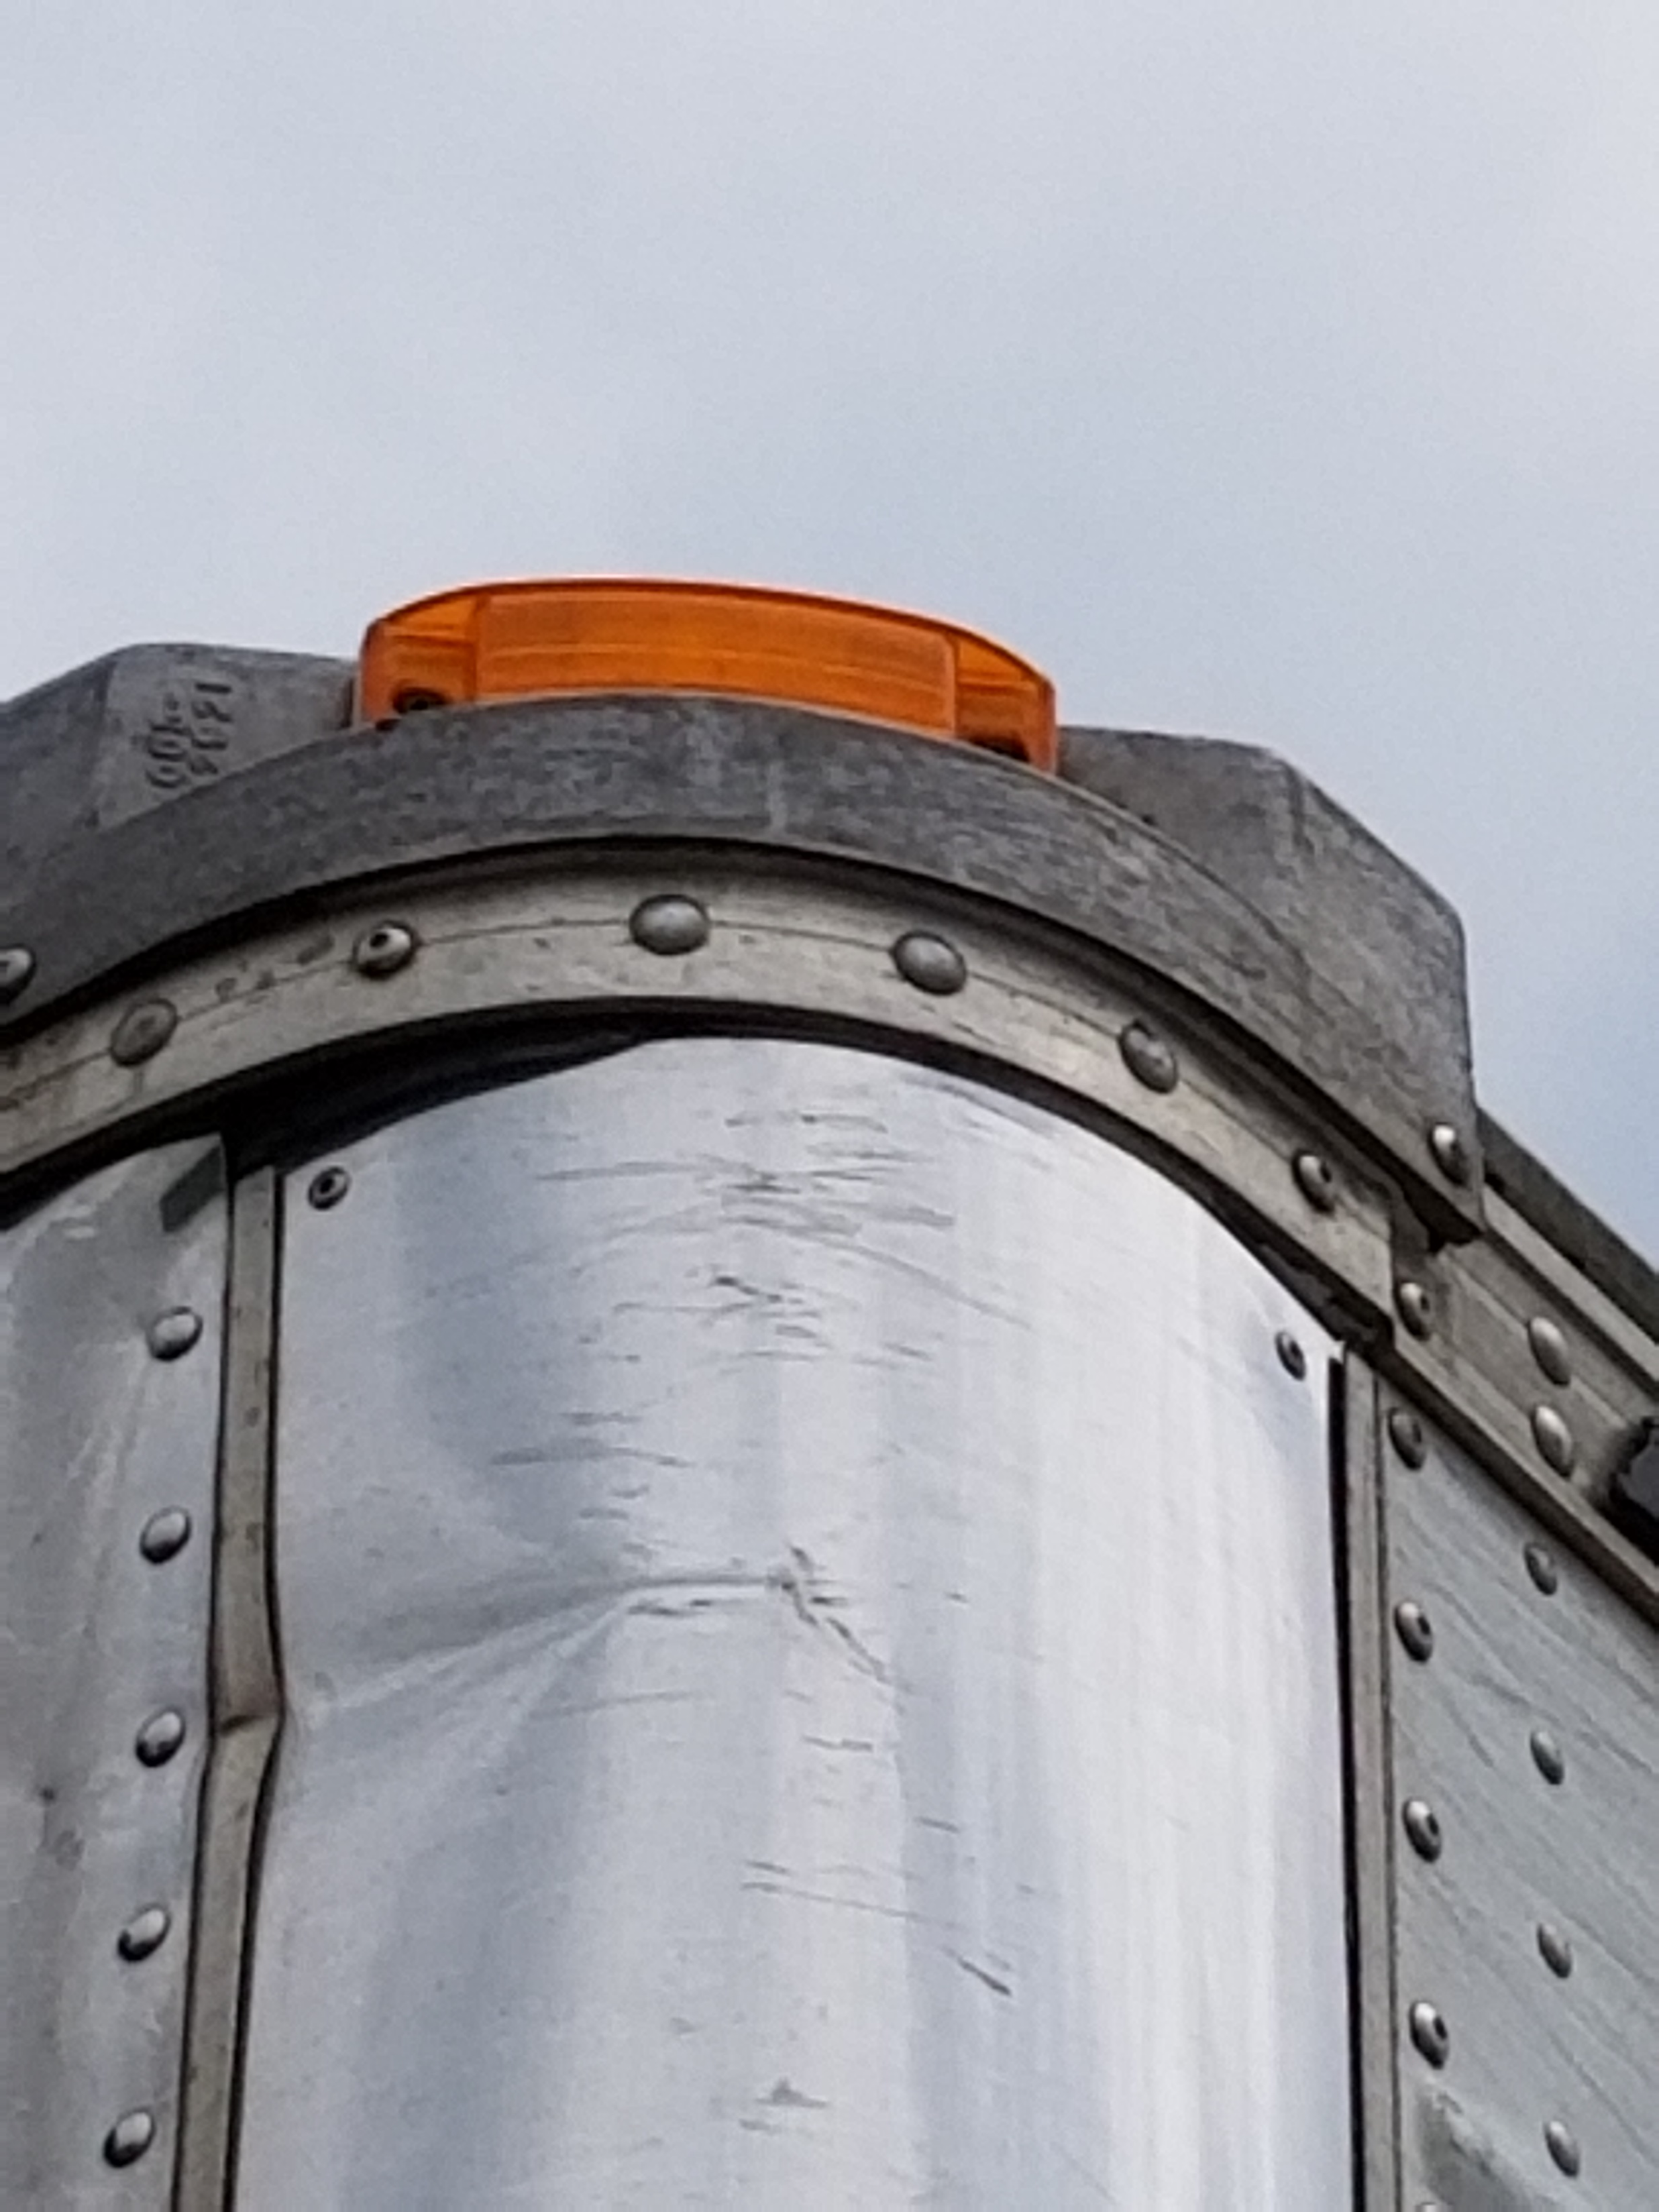
Head board of the trailer, lights (Clearance)

Slide 3
Side of the trailer. Body and lights markers at the bottom. Clearance at the top.

Slide 4
Landing gear and frame crossmembers

Slide 5
Trailer body cross members.

Slide 6
Middle marker light (amber): turn signal and hazard.

Slide 7
Frame and slider box.

Slide 8
Axle section. Start with the wheel. Tire, rim, lug nuts and hub seal.

Slide 9
Check tire depth, check for debris in between.

Slide 10
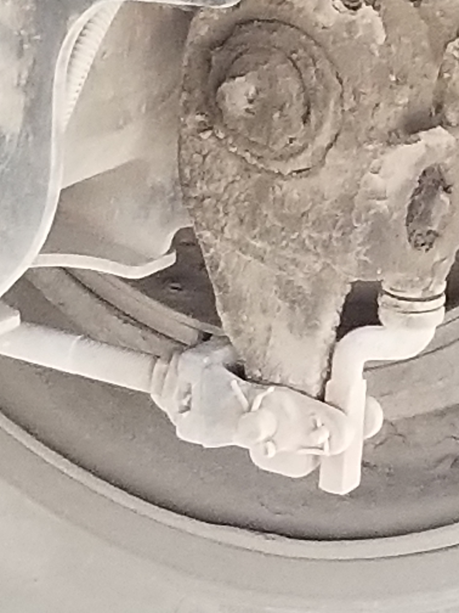
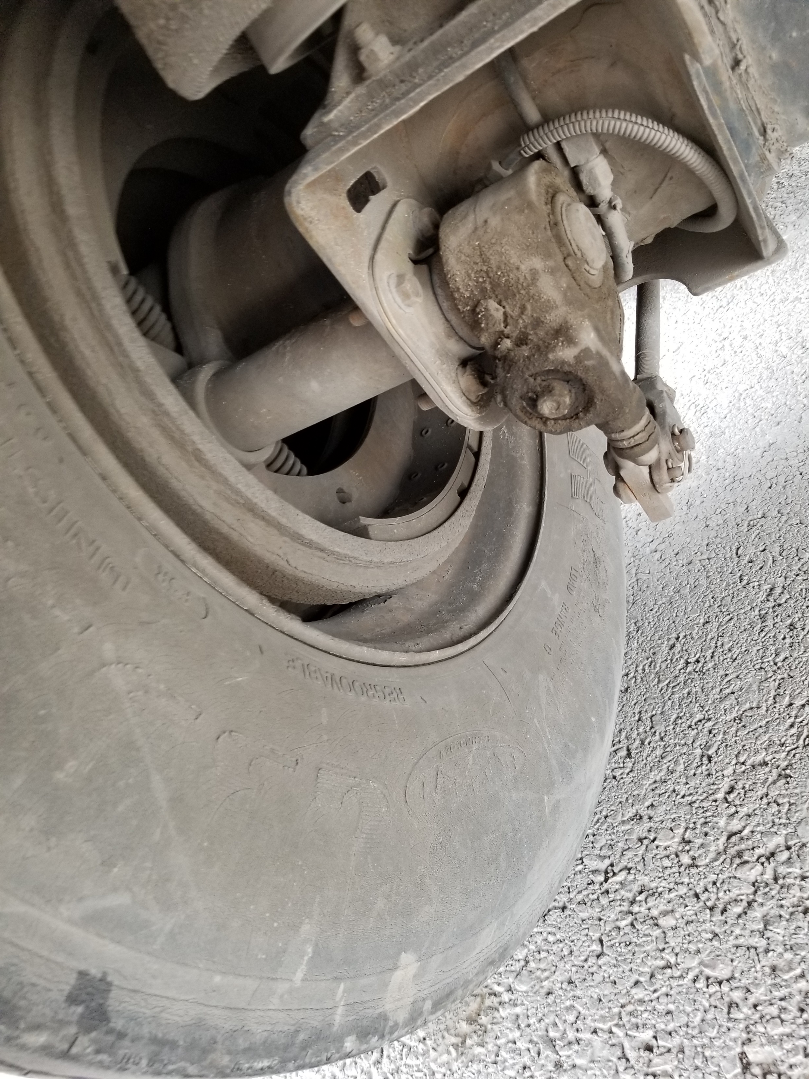
Brakes: Drum, shoes, slack adjuster / pushrod…

Slide 11
…brake chamber and brake hoses.

Slide 12
Suspension: Torque arm, Torque arm mount, bushing, shock, air bag and mounts. NO u-bolts

Slide 13
Mud flap, no higher than 8” off the ground.

Slide 14
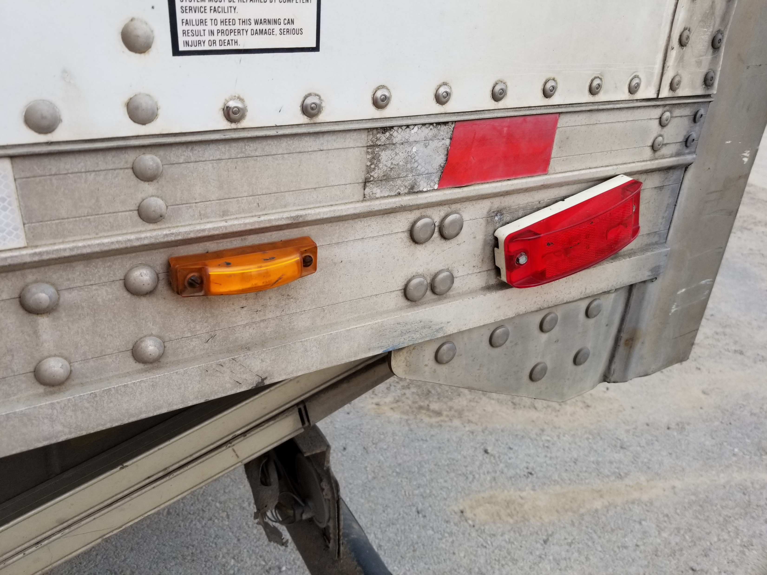
Door tie, ABS light (amber), rear marker light (and clearance light) red.

Slide 15
Rear clearance lights, doors, hinges, latches, lift gate.

Slide 16
Rear lights: Tail lights, brake lights, turn signals and hazards. DOT bumper and reflectors

