Slide 1
Part A
Front of the truck

Slide 2
Leveled vehicle, lights, leaks

Slide 3
Open hood, start with the axle. Wheel first

Slide 4
Inspect tread depth, Inflation and inside.

Slide 5
Brakes are next. Rotor, caliper, pads, chamber and hoses.

Slide 6
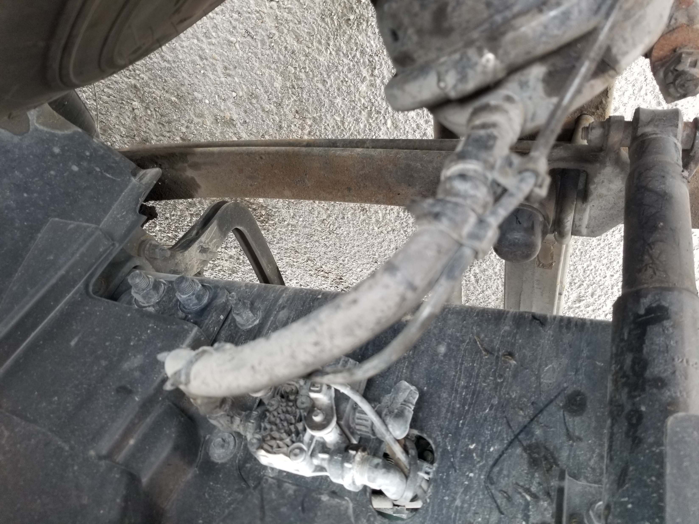
Suspension. Mount, leafspring, bushing, u-bolt, shock, upper and lower mounts.

Slide 7
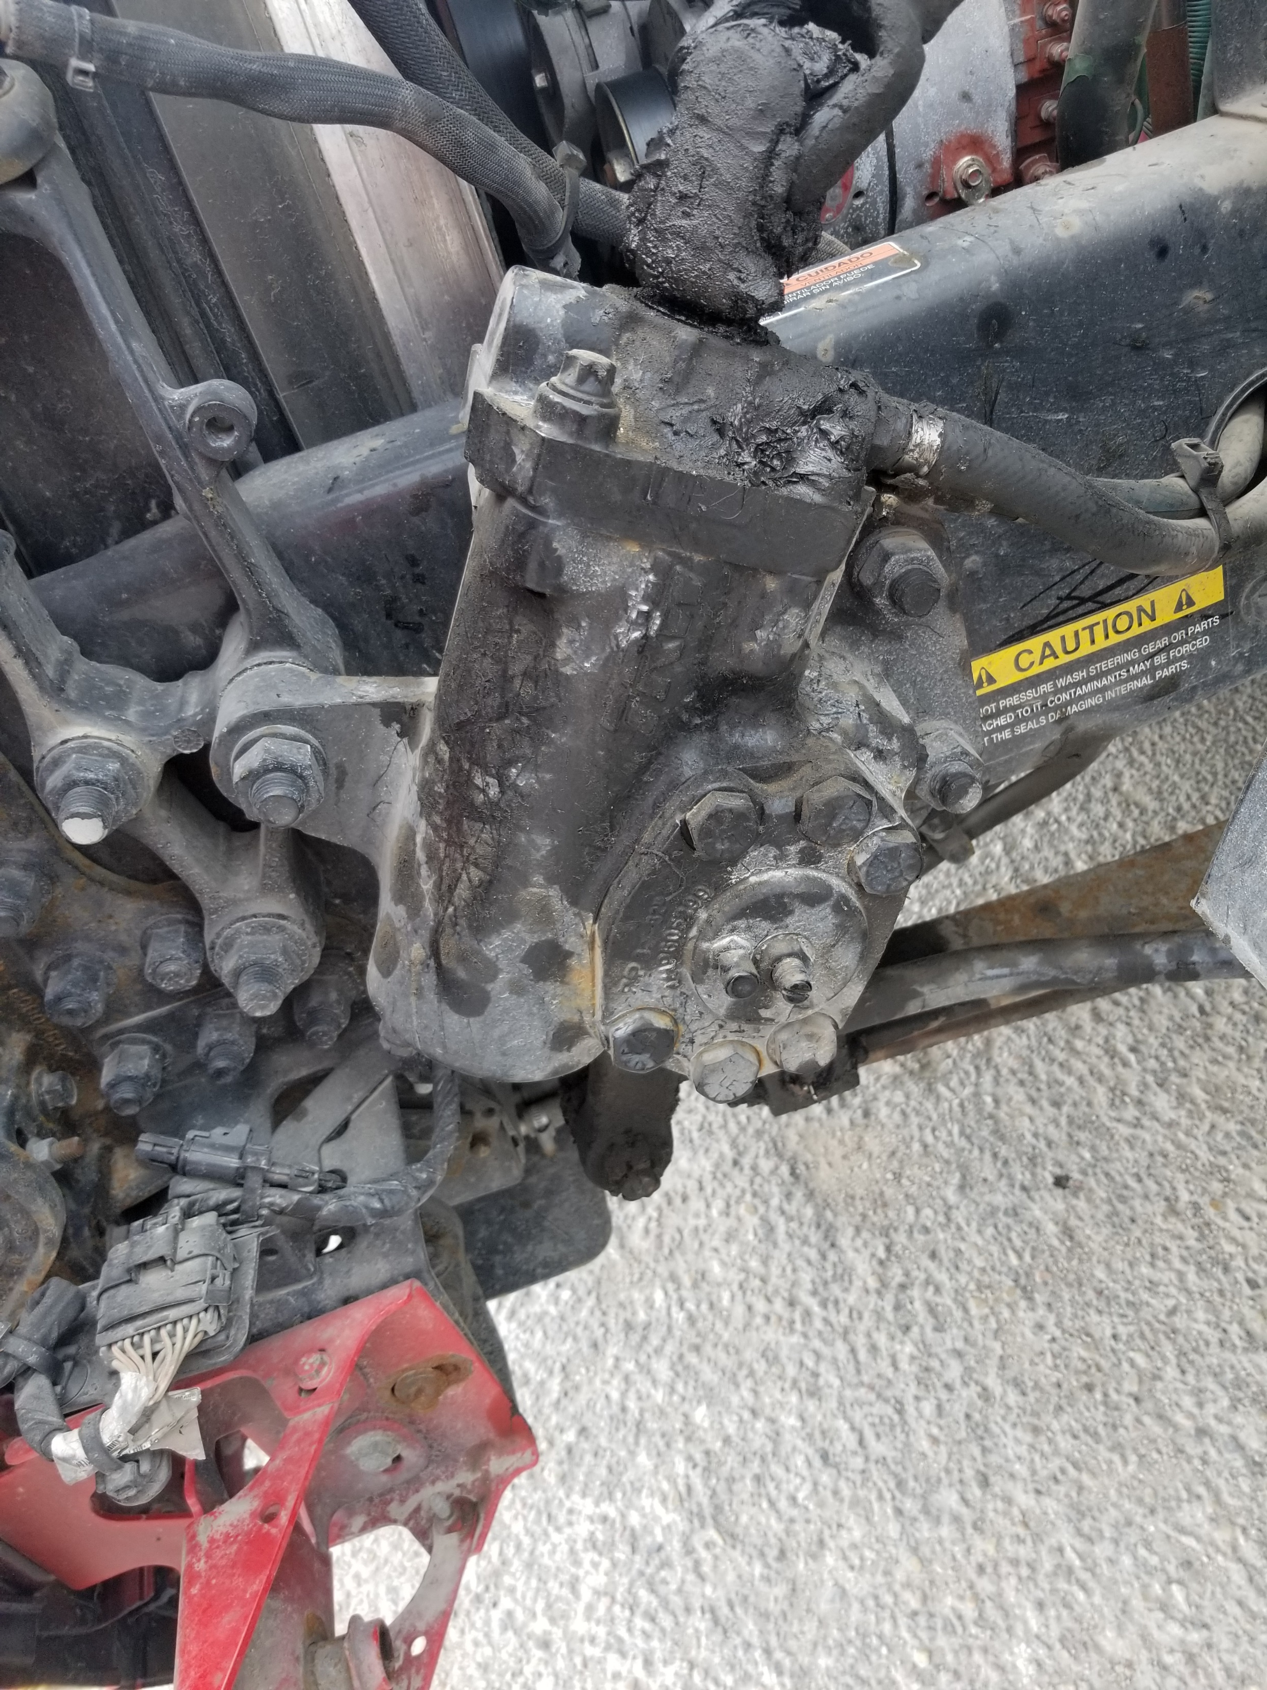
3-pc Steering linkage and steering box w/ hose

Slide 8
Air compressor and power steering pump. Gear driven

Slide 9
Power steer reservoir and oil level. All other hoses/connections. Check for leaks

Slide 10
Alternator, belt driven

Slide 11
Coolant reservoir and related hoses.

Slide 12
Water pump, belt driven

