Slide 1
Coupling Section

Slide 2
Hose fittings and hoses. Electric outlet, socket and cable (green)

Slide 3
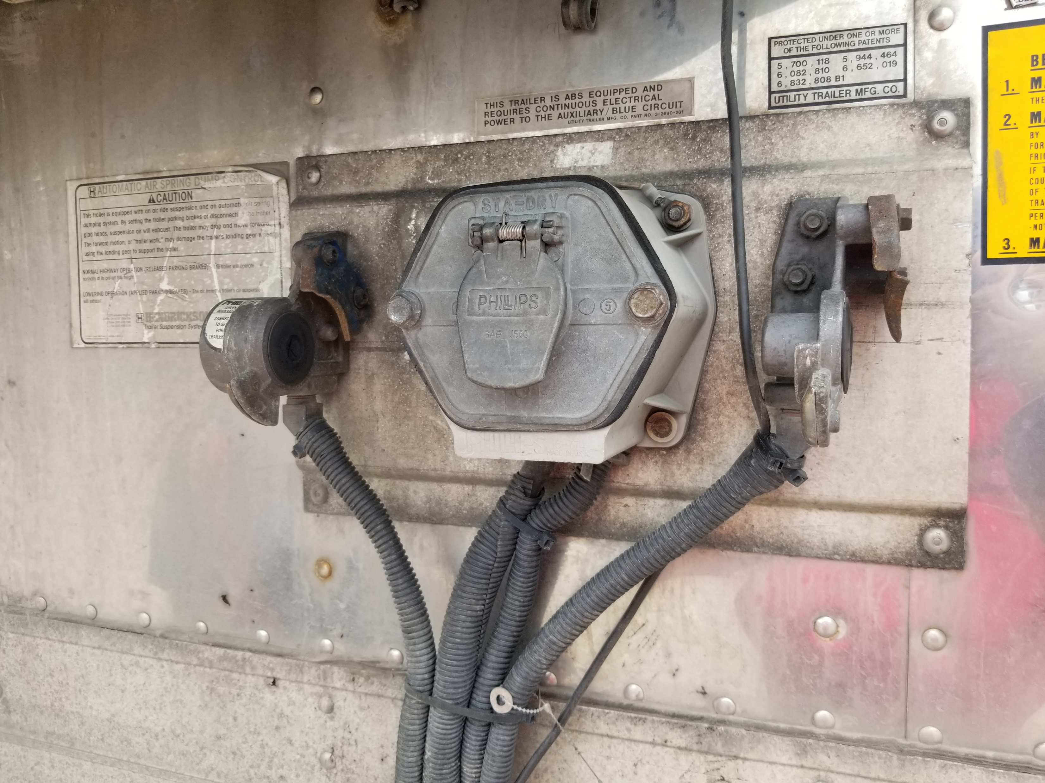
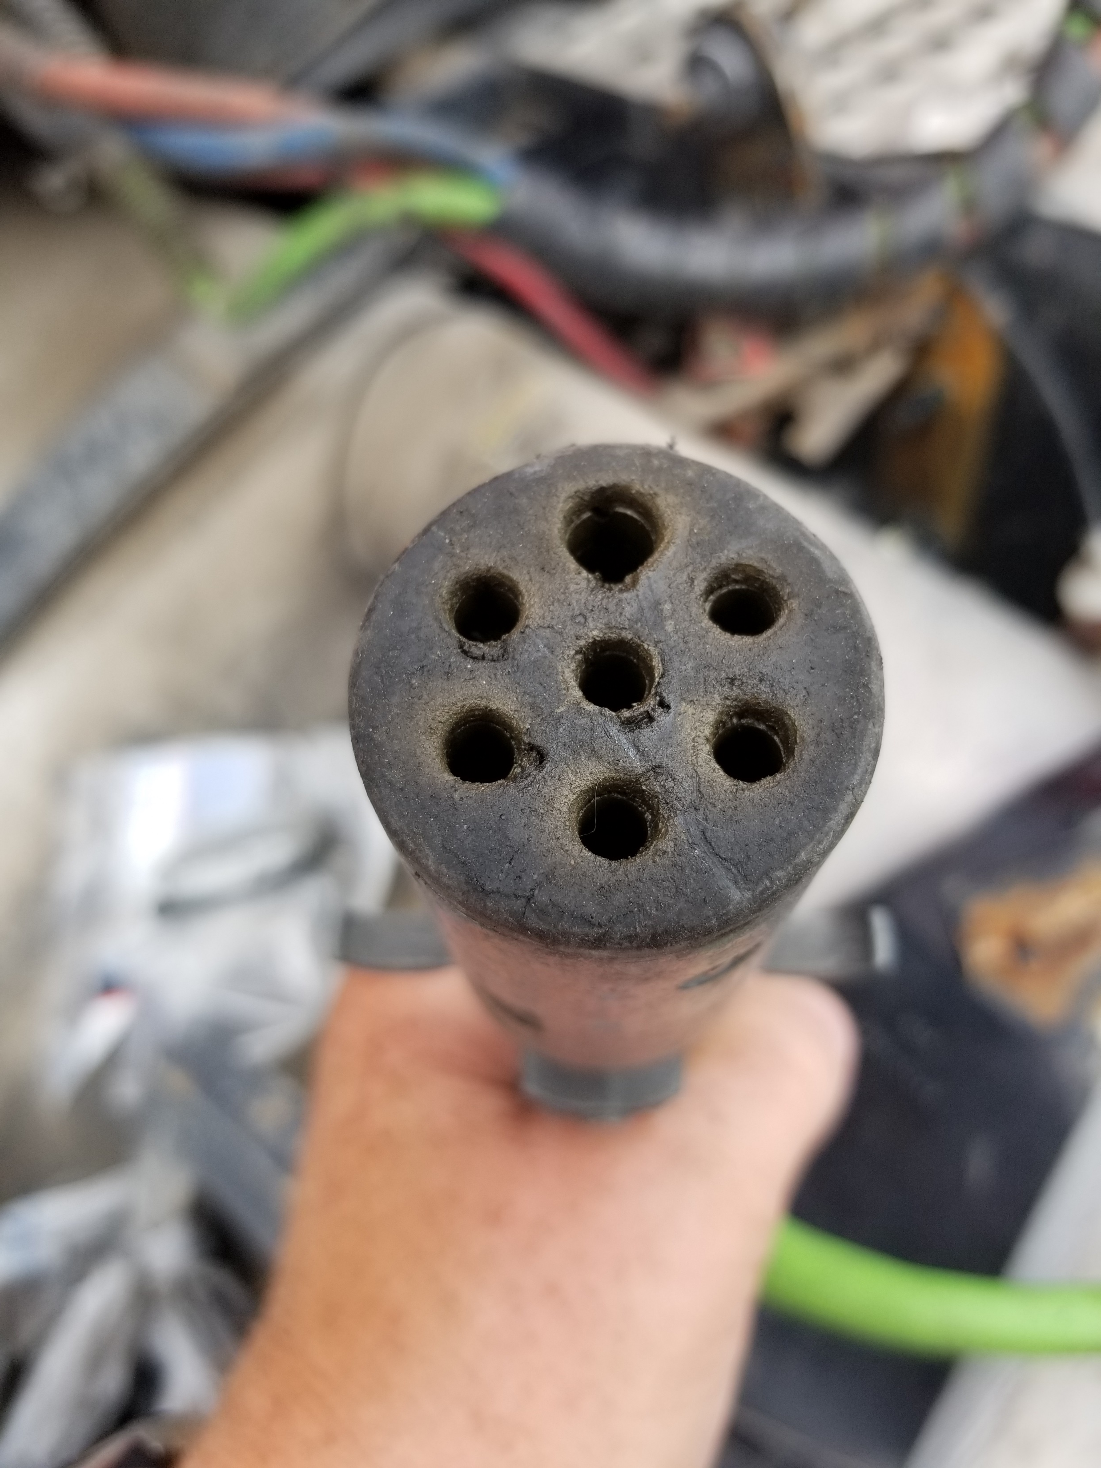
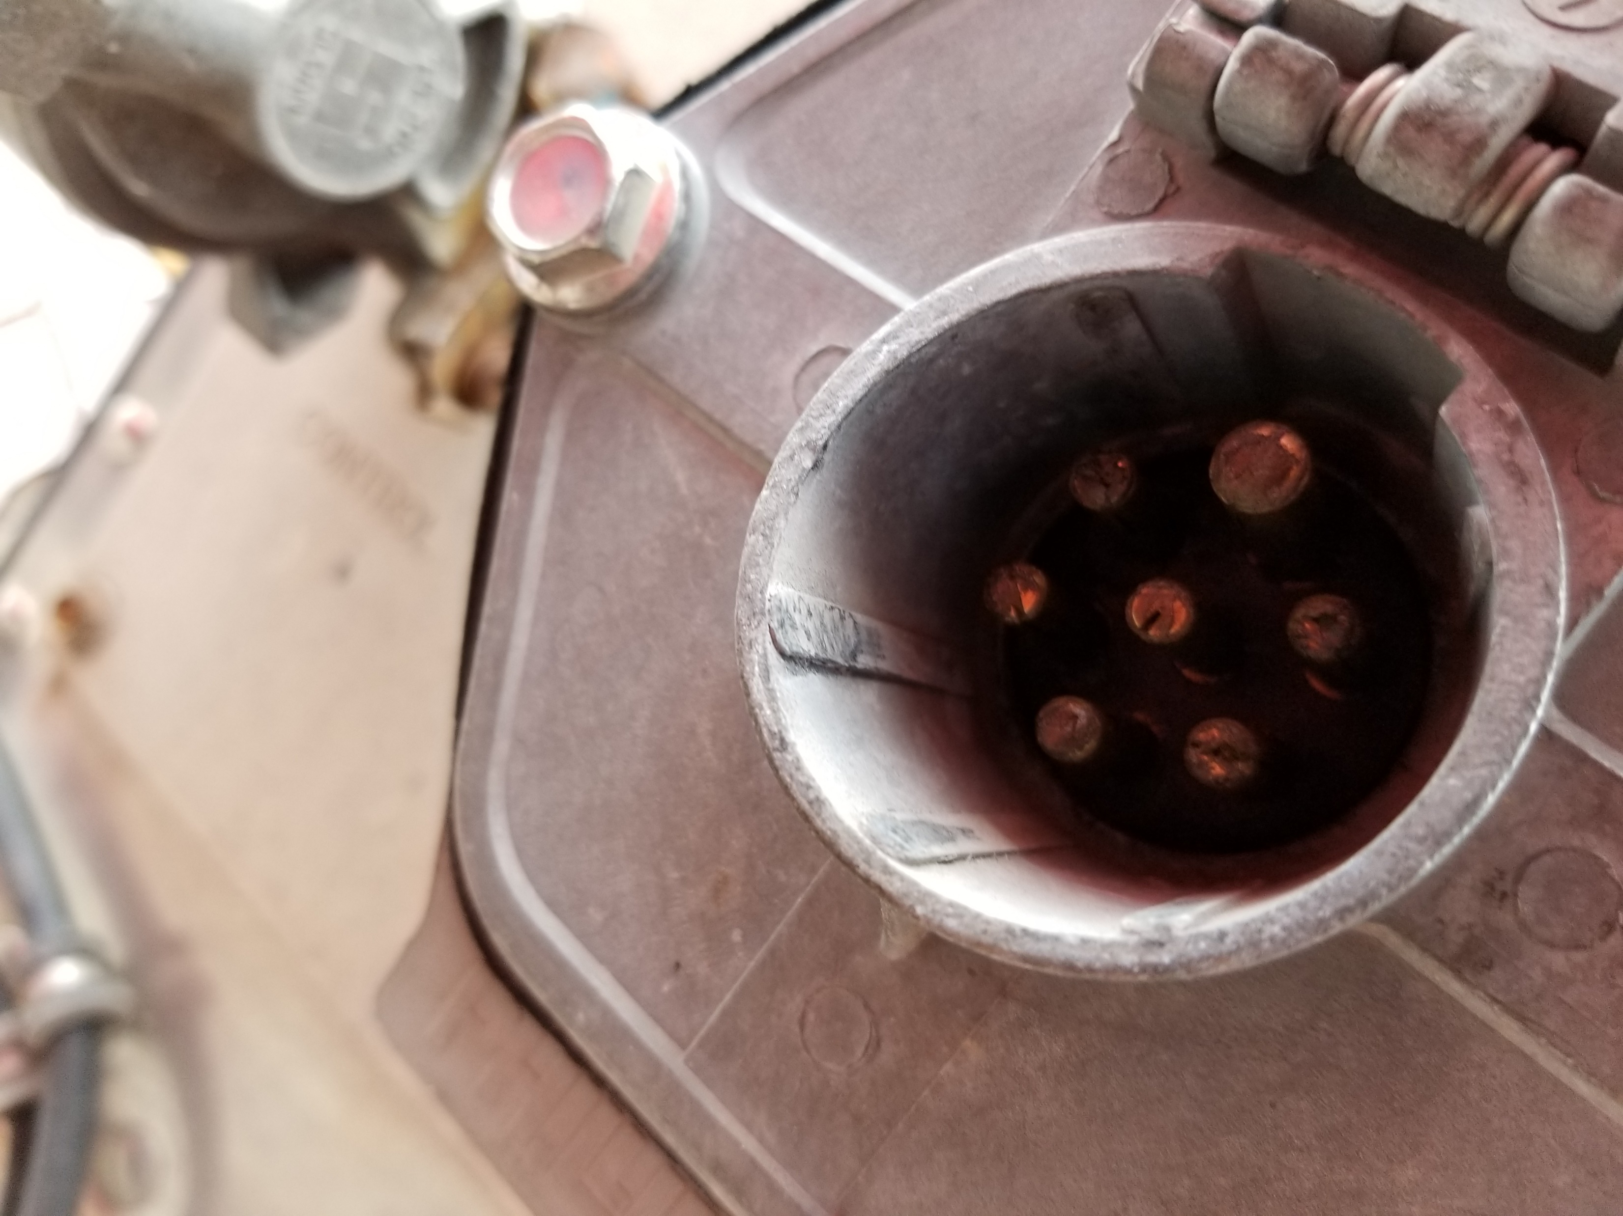
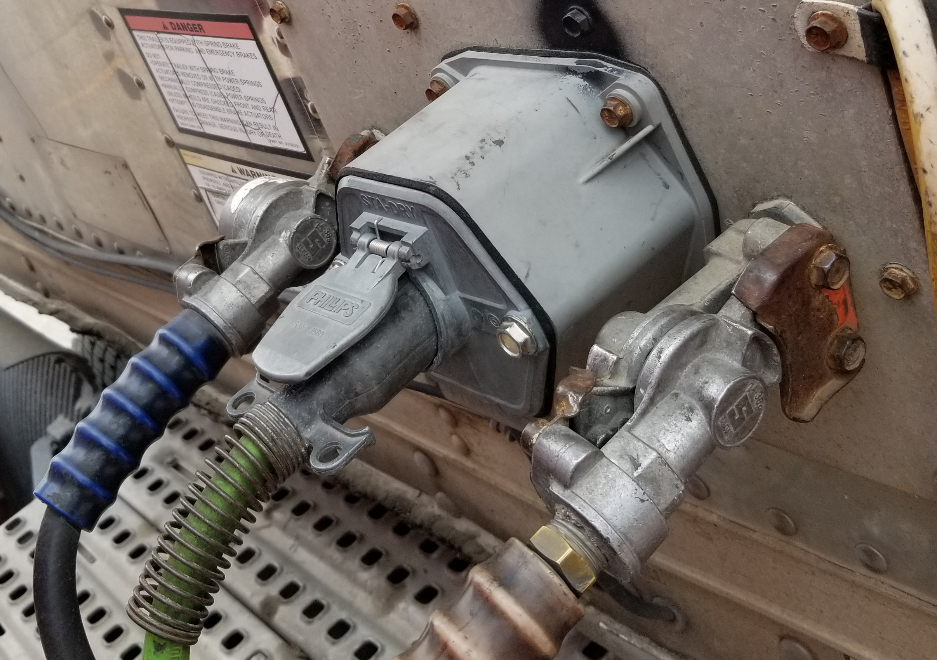
Check the connections at the other end both air and electric

Slide 4
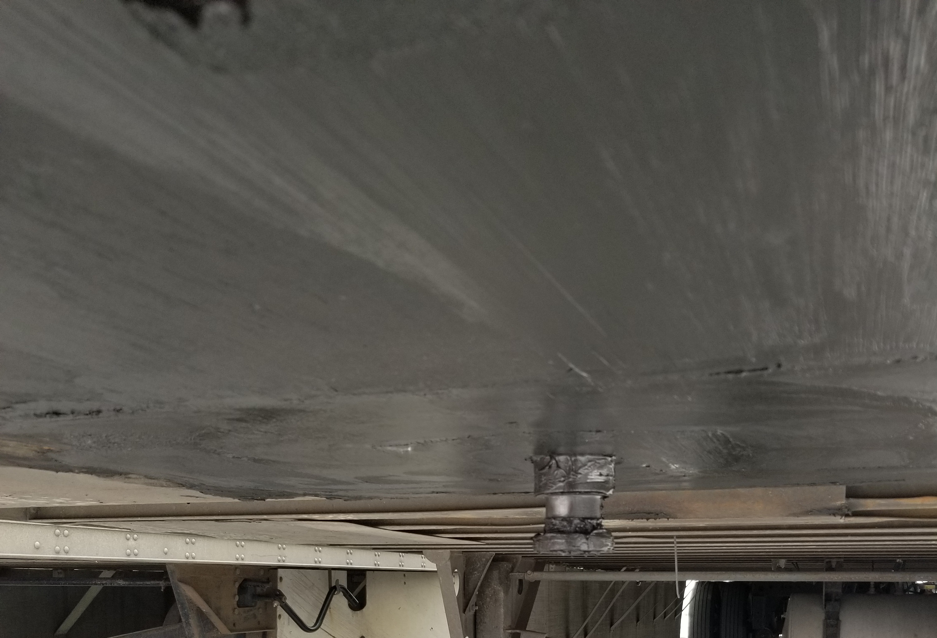
Apron and Kingpin

Slide 5
Skidplate

Slide 6
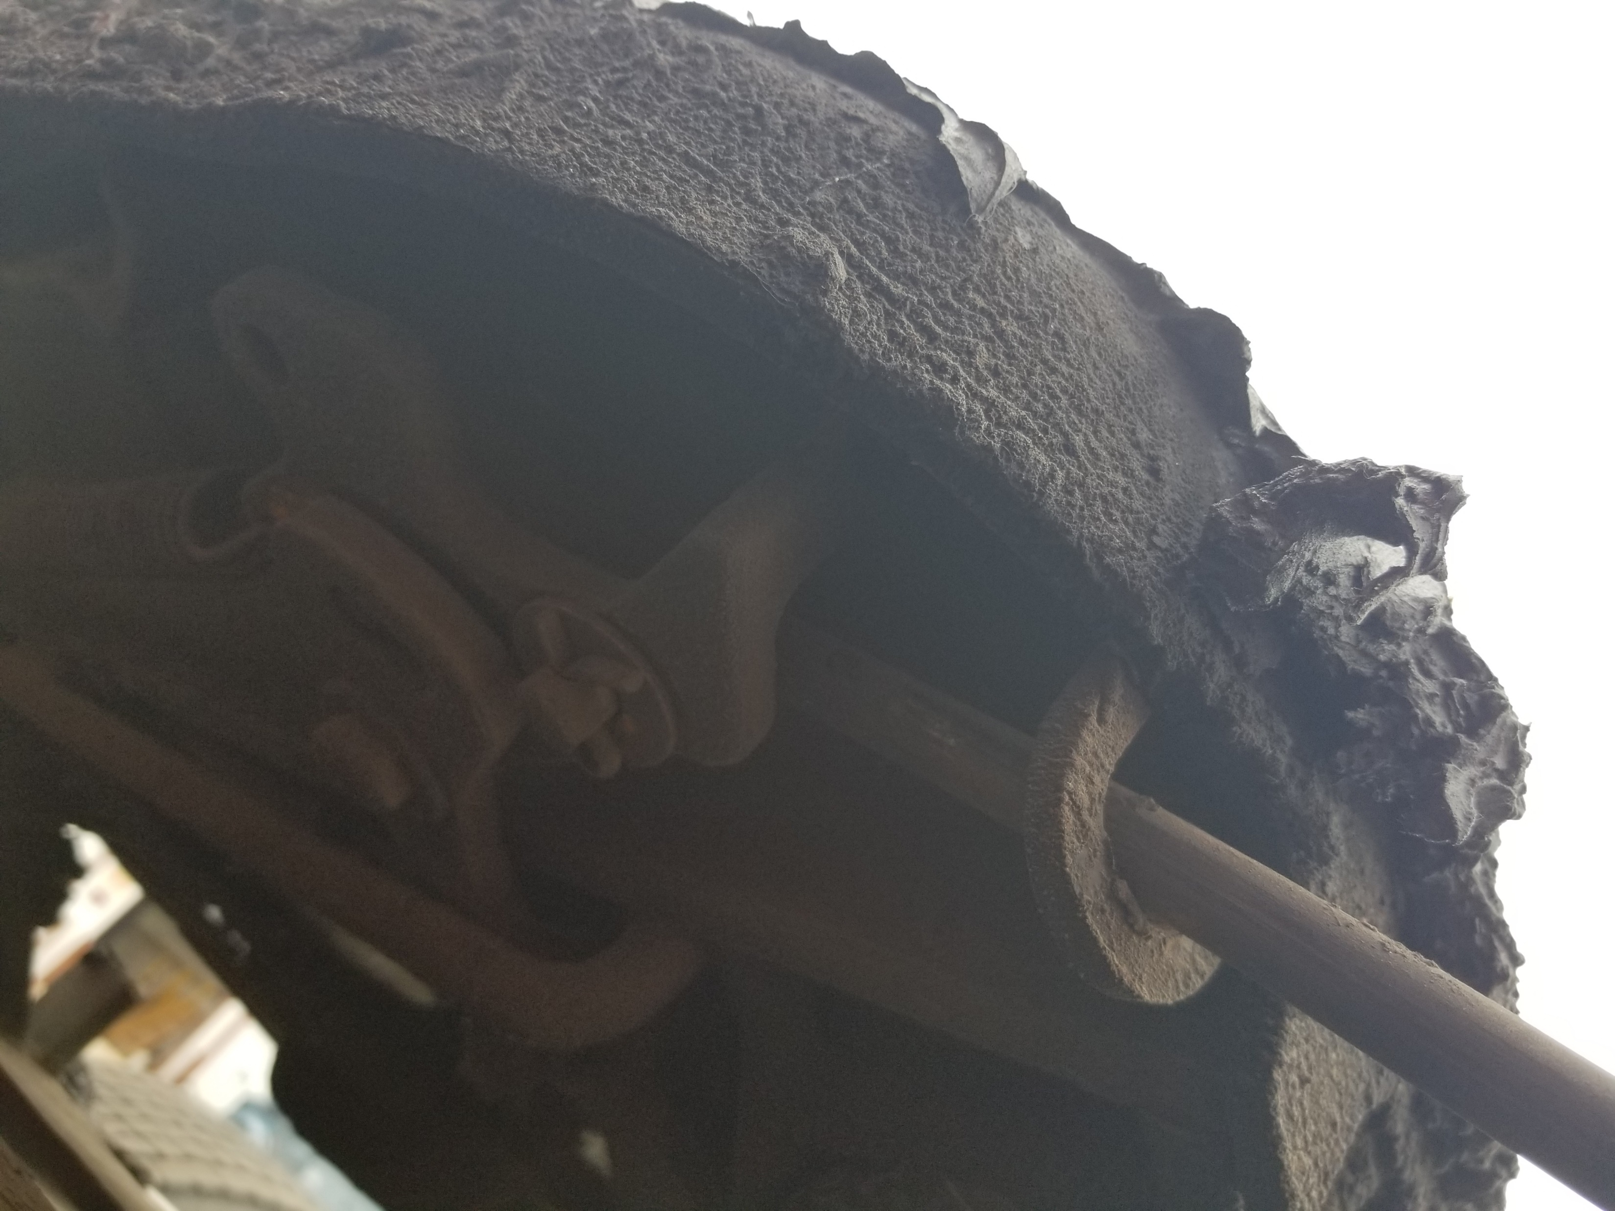
Release handle and safety latch
Bottom View

Slide 7
Platform and mounting bolts.

Slide 8
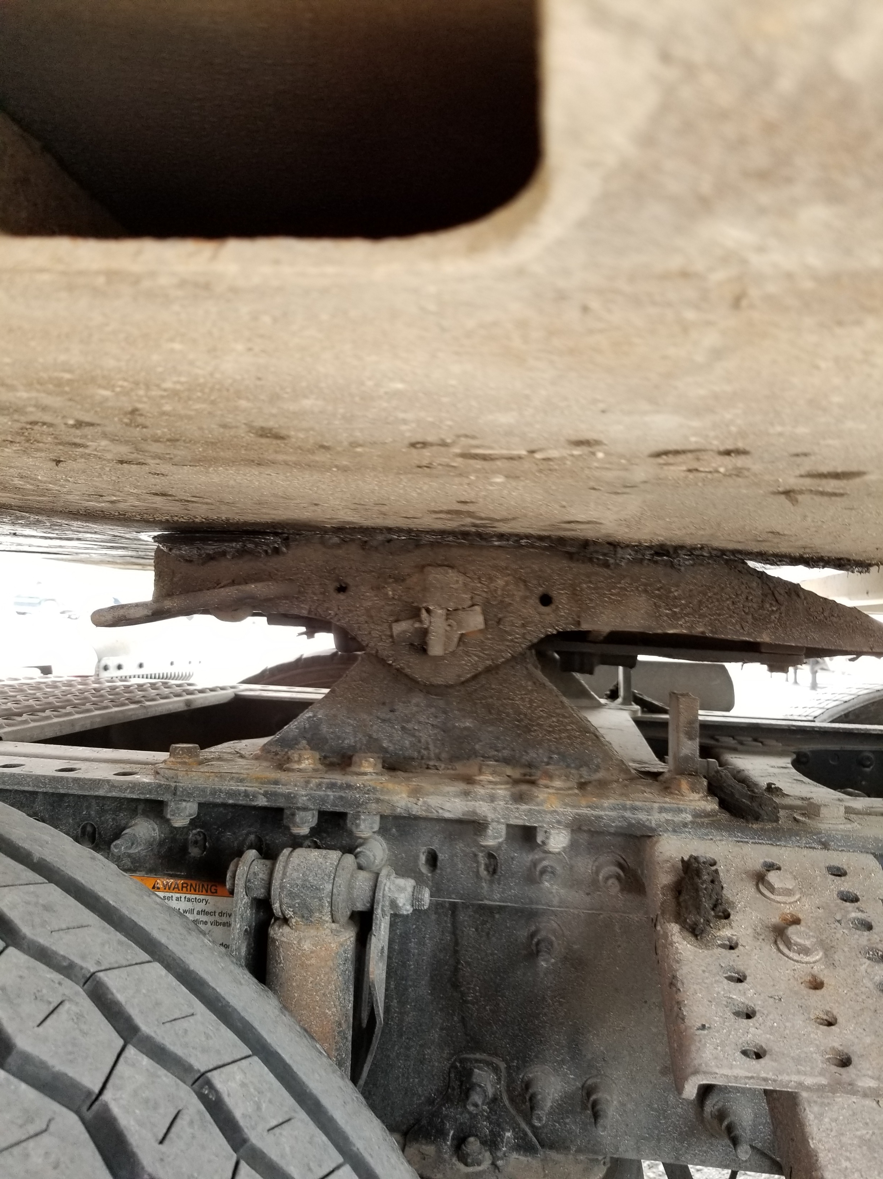
Locking jaw and no gap

